Slide 1
Data Understanding
EDA statistical analysis using R and data visualization using tableau

Slide 2
Analytical Approach
Classification Analyses because:
Type of Target variable “fraud” is binary 0/1
Type of business question: predict a transaction is fraudulent or not
Measure of Success:
Confusion Matrix
PCC

Slide 3
Code book
Structured Data in flat file csv
150000 observations with 12 features
Target variable “Fraud” loaded in R as int instead of factor. So transform it to factor.
TV “Fraud” is unbalanced: (90%) 0:135957 & (10%) 1: 14043. So either use imbalanced data with F1 Measure or balance it using Over/Under sampling.
211,358 observations of ip_mappings.csv with badly formatted Start_ip (like fec0::) and end_ip (like ffff:ffff:ffff:ffff:ffff:ffff:ffff:ffff). So go back to source and recollect correct data.
Feature “Sex” have 90,057 (60%) as “Not Provided”. So Use it as a category for prediction.
Skewness of “Amount” = 0.67 and of “Age” = 0.42. So transform using John tukey ladder to fix skewness

Slide 4
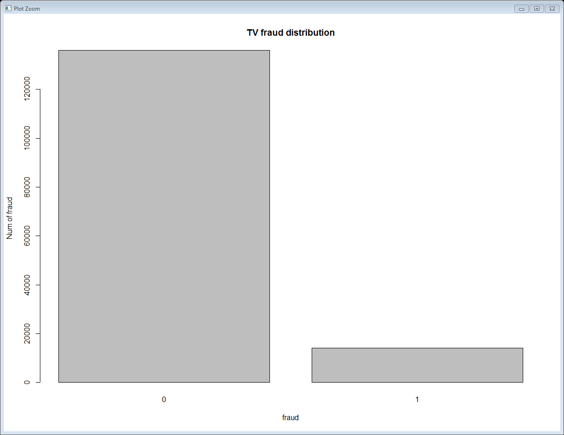
Data Visualization (Bar graph)

Slide 5
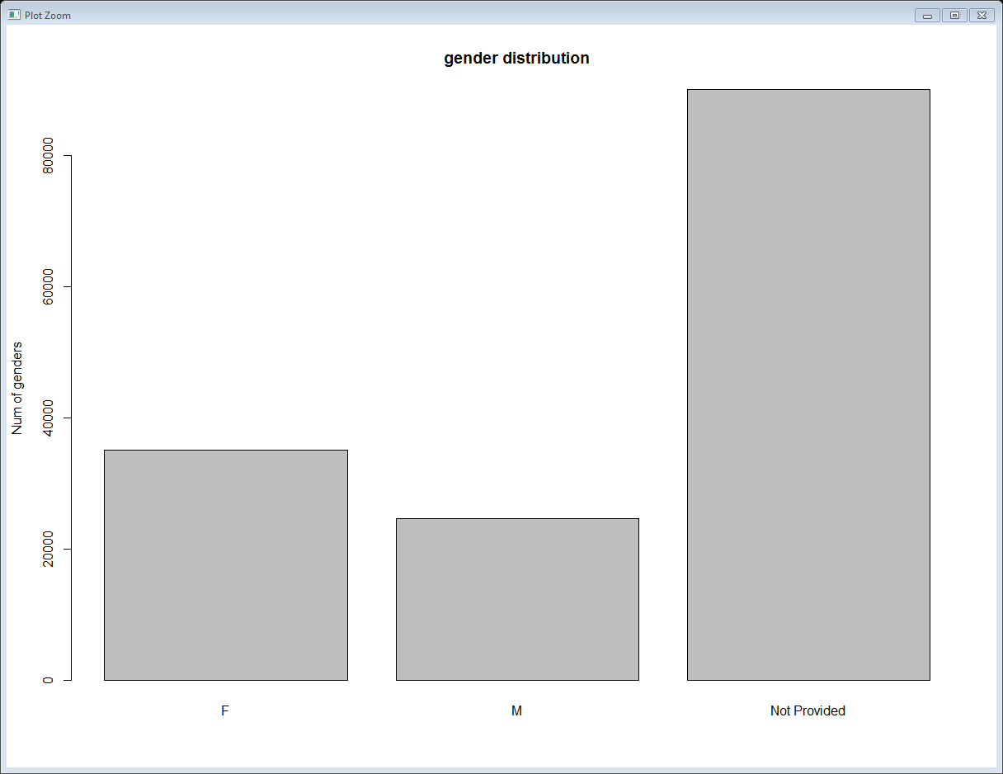
Data Visualization(Bar graph)

Slide 6
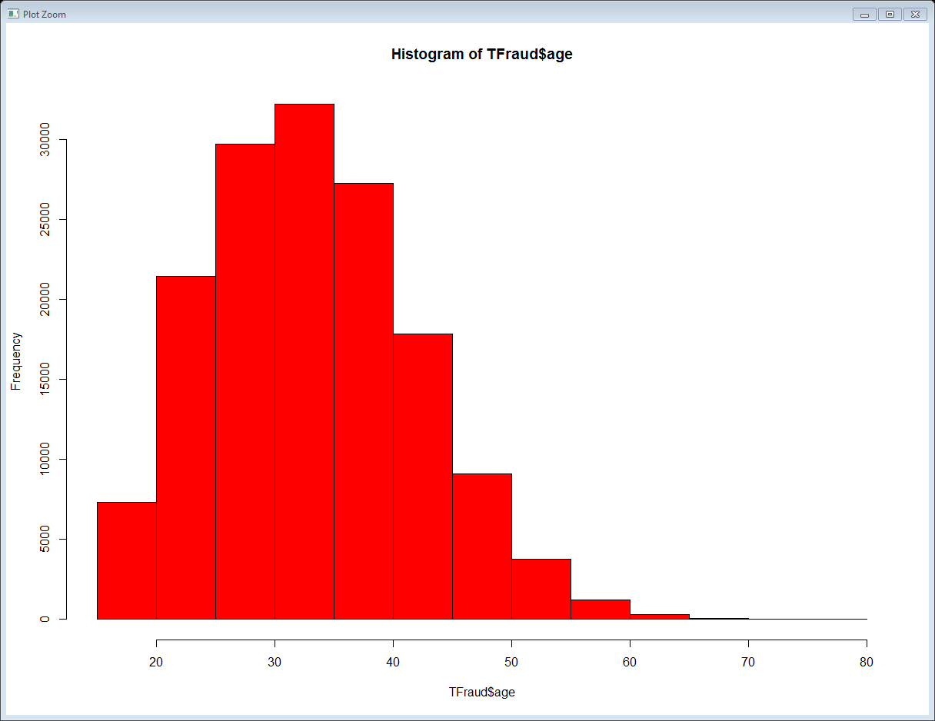
Data Visualization(Histogram)

Slide 7
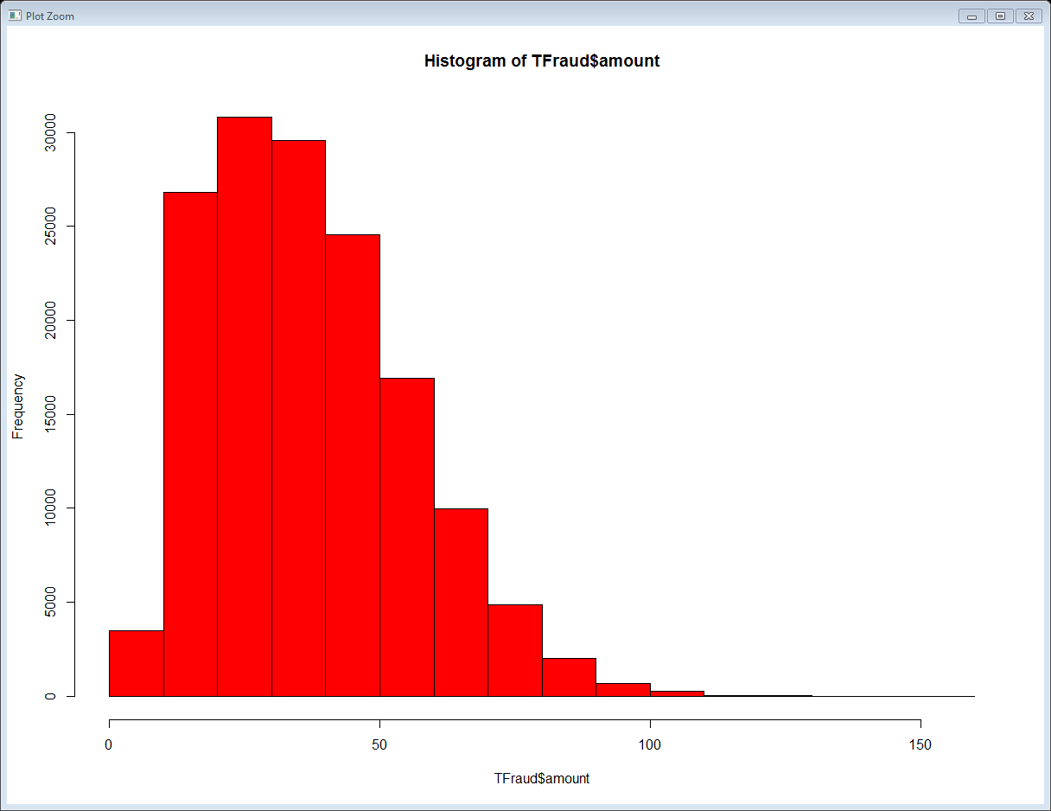
Data Visualization(Histogram)

